Slide 1



ENGINEERING
SOFTWARE

Slide 2








SOFTWARE
Software consists of computer programs that instruct the execution of a computer.
Software provides a single interface to the user to obtain results for a variety of requests.
Software is the controlling unit of the hardware.

Slide 3

SOFTWARE
Software acts as an interface between the user and the hardware.
Software or hardware alone is useless.
$$Software =computer program + procedures+rules+associated documents+data$$

Slide 4
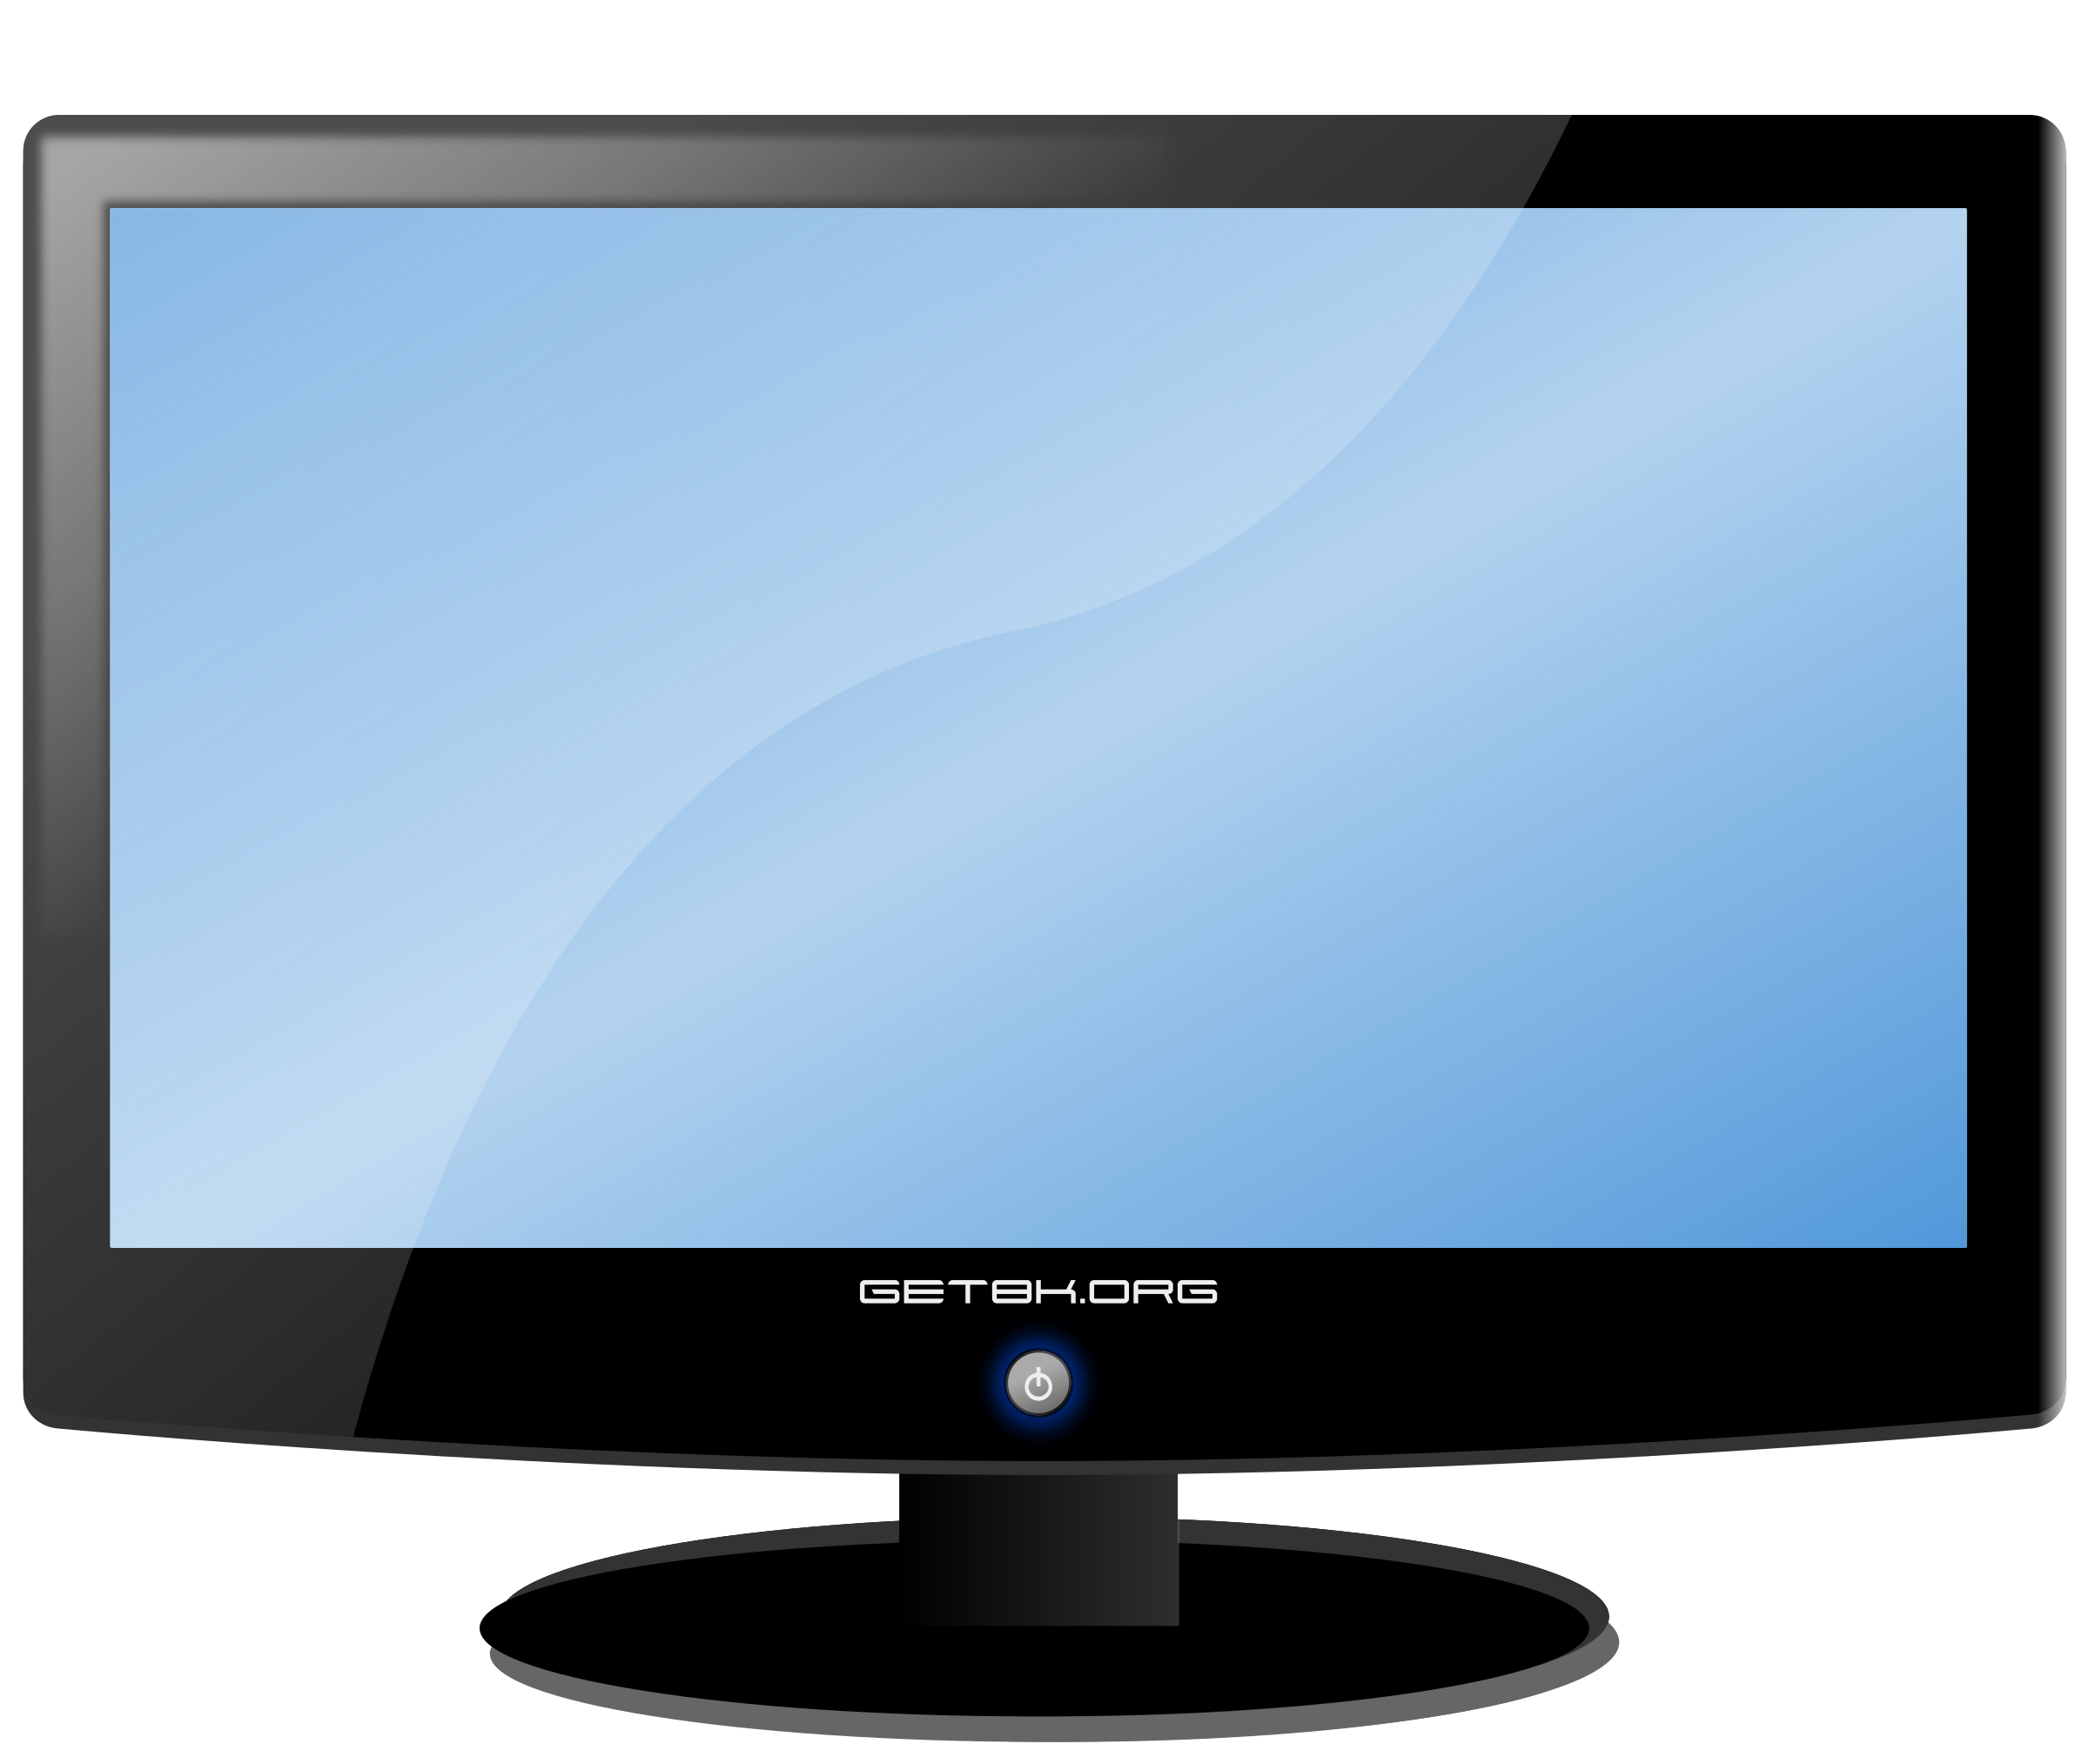

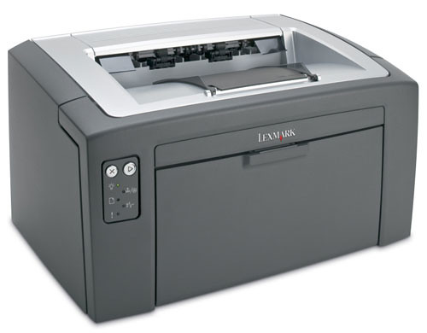
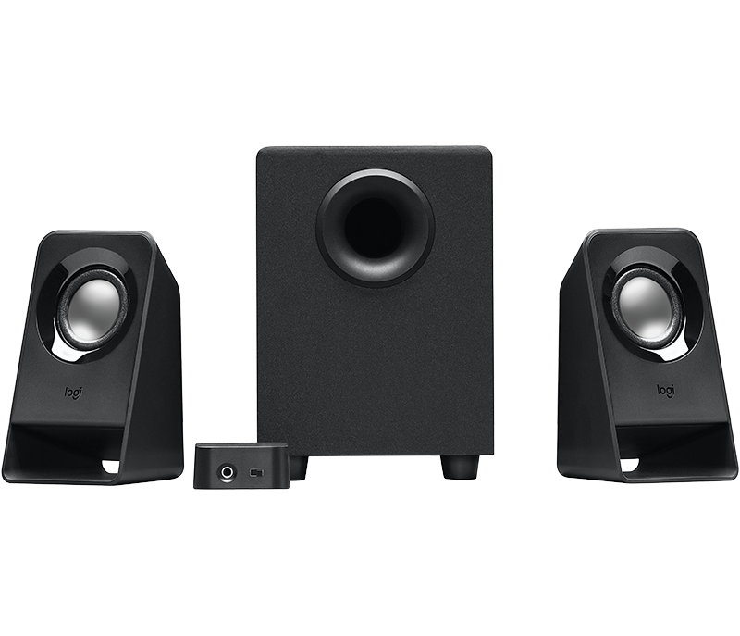

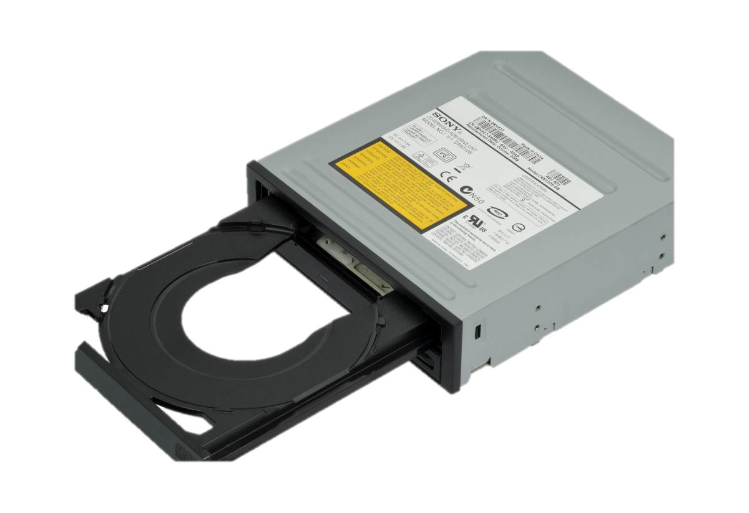
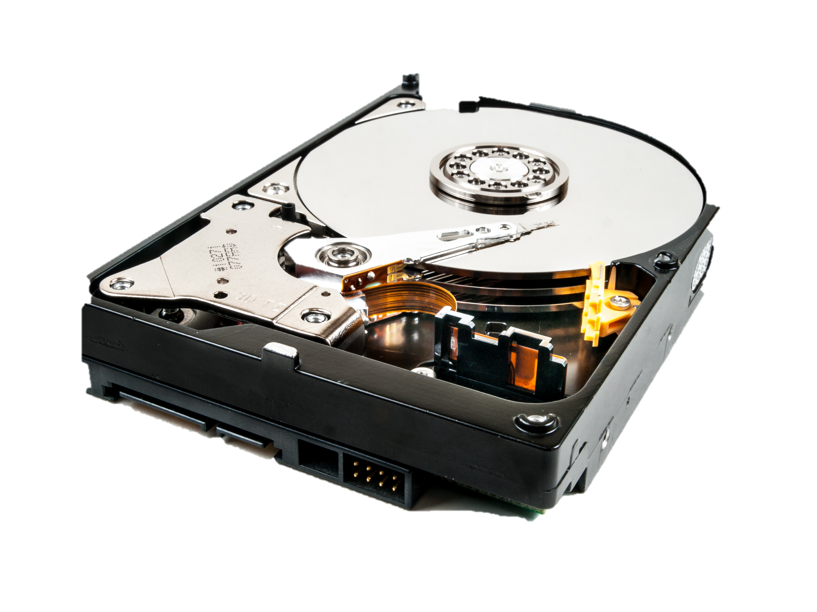
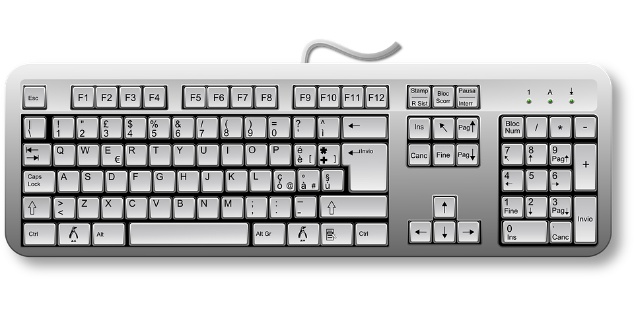
SOFTWARE
HARDWARE

Slide 5







Software
System Software
Application Software
System Software controls the operation of the hardware components
Eg: Operating Systems, utility programs and device drivers
Application software is a type of computer program designed to help users perform specific tasks or functions.
Eg: Games, Browsers, Word processing software …

Slide 6
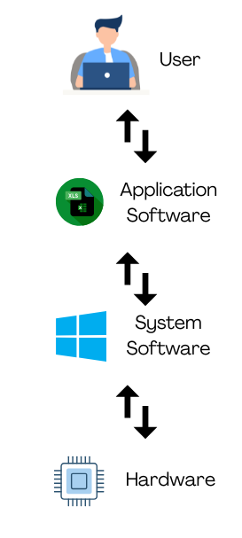
WORK FLOW

Slide 7
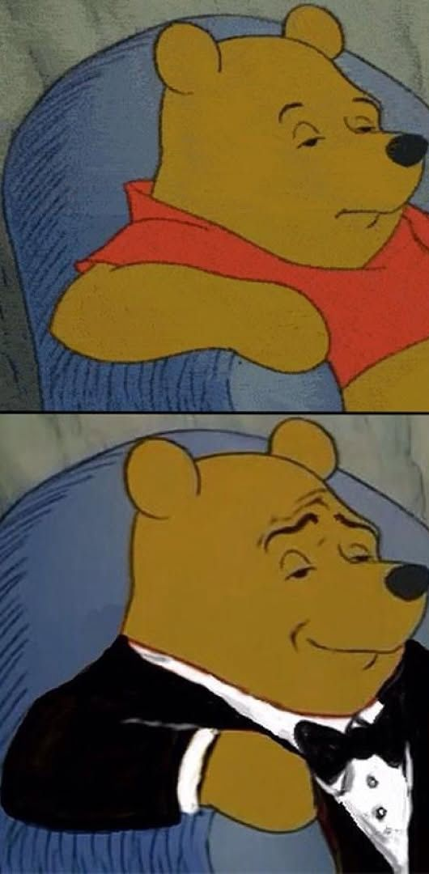
SOFTWARE ENGINEERING
Software Engineering is the process of designing, developing, testing, and maintaining software.
It is a systematic and disciplined approach to software development that aims to create high-quality, reliable, and maintainable software.
Programmer
Software Engineer

Slide 8
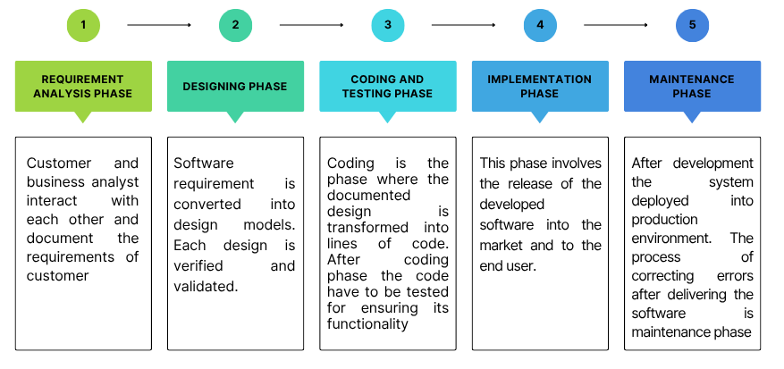
PHASES IN SOFTWARE DEVELOPMENT

Slide 9
SOFTWARE PROCESS

